Slide 1
Proof of Concept for Prehospital Stroke Predictor Model
Kristine C. Mechem PhD
Mark Borsody MD PhD, Grace Montenegro MS, Yibo Li (principal authors)

Slide 2
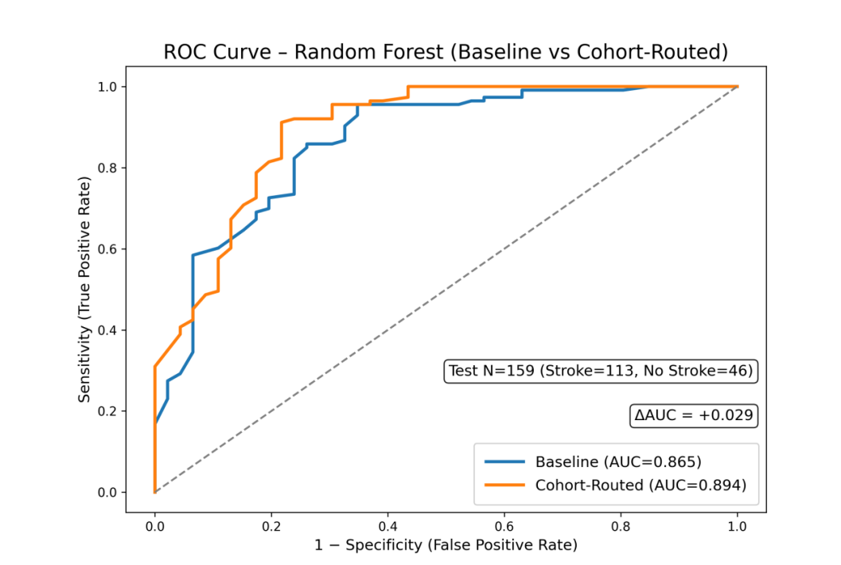
Proof of Concept for a Pre-Hospital Stroke Predictor Model Mark K. Borsody, MD/PhD (Queen of Valley Hospital), Grace Montenegro MS-CES (ODY-C Inc), Kristine C. Mechem PhD (ODY-C Inc), Yibo Li PhD (University of Massachusetts)
Objective
Design/Methods
Results
To develop and evaluate an artificial intelligence-based clinical decision support system that improves the accuracy and clinical utility of stroke diagnosis in prehospital settings, thereby:
Accelerating patient routing to neuroimaging
Decreasing time to diagnosis
Optimizing patient treatment
Increasing patient treatment with thrombolytics
Routing patients with suspected large vessel occlusion to Comprehensive Stroke Centers
Samples were pulled from the Geissinger FABS data base of 780 patients which contains stroke/non-stroke patient features such as sex, race, age, smoking, blood pressure, blood sugar, history of atrial fibrillation and seizures, and facial droop.
The FABs database is comprised of consecutive patients presenting with acute, stroke-like symptoms within 4.5 hours of onset in two tertiary care centers over a three-year period (2012-2014).
We created two data sets: Training set of n=633 (XXX stroke and XX non-stroke) and a test set of n=159 patients (113 stroke and 46 non-stroke)
Models were developed using neural networks, random forest, and XGb
Cohort routed model developed algorithms to assess accuracy of data
Facial droop and absence of atrial fibrillation are strong predictors of stroke in a hospital environment (original FABS analysis 94% and 96% sensitivity, respectively).
Other characteristics in FABS were more predictive of stroke mimics (seizure history and isolated sensory deficit with 97% and 97% specificity, respectively).
By correcting mislabeled or miscategorized data through a machine learning approach we were able to increase sensitivity to 97% with a small improvement in specificity (63% versus 65%).
Our approach improved stroke prediction from the common stroke models developed for a prehospital setting (FAST and BEFAST sensitivity 77% and 68%, specificity 60% and 85%).
We have developed a proof of concept based on only one NIHSS clinical covariate recommended for prehospital use that has high predictive value.
Demographics and Characteristics of Test Set
Attribute | Stroke | Non-Stroke
Age (median) | 68 | 51
Race(% Black) | 39.8% | 45.7%
Sex (% female) | 46.9% | 37.0%
Facial Droop | 72.6% | 10.9%
NIHSS (median) | 9 | 4
Background
Stroke remains one of the leading causes of mortality and disability worldwide with a US incidence rate of ~800,000 and ~150,000 deaths yearly.
Less than one out of five patients eligible for thrombolytics are treated due to expiry of the treatment window, resulting in poor outcomes for many stroke patients.
Timely and accurate differentiation between stroke and non-stroke patients in pre-hospital environments is critical to improving outcomes and reducing the time to treatment.
Stroke screening tests perform poorly in ambulance settings due to poor specificity (many false positives) and/or poor sensitivity (many missed strokes).
Clinical scales and predictive models often lack sufficient accuracy and ease of use under real-world conditions, resulting in patients sometimes being routed to a hospital that cannot meet their clinical needs.
An AI trained model run in an ambulance setting could also avoid unnecessary transfers to non-specialty hospitals.
Predictive Accuracy of Baseline Model
Predictive Accuracy of Cohort Routed Model
Conclusion
Clinical Dx Call | Actual No Stroke | Actual Stroke
Predicted Non-Stroke | 30 | 8
Predicted Stroke | 16 | 105
Total | 46 | 113
Clinical Dx Call | Actual No Stroke | Actual Stroke
Predicted Non-Stroke | 29 | 4
Predicted Stroke | 17 | 109
Total | 46 | 113
Our analysis demonstrates a clinical decision support tool that is clinically interpretable and scalable in a prehospital setting.
Our analysis confirms the usefulness of one of the clinical covariates (facial droop) recommended for prehospital setting.
We have currently developed a prototype for an easy to use collection device that fits in the ambulance workflow.
Our next steps are to test the prototype in a real world setting, to complete AI models for other clinical covariates (slurred speech, eye tracking, arm/leg strength, and involuntary movements), and to train a ML model on additional clinical covariates that further increases the predictive ability of a stroke predictor model.
Sensitivity = 0.93
Specificity = 0.65
Accuracy= 0.85
Sensitivity = 0.97
Specificity = 0.63
Accuracy= 0.87
FAST (meta analysis) BEFAST (meta analysis) Our Model
Sensitivity = 0.77 Sensitivity = 0.68 Sensitivity = 0.97
Specificity = 0.60 Specificity =0.85 Specificity = 0.63
Accuracy = 0.76 Accuracy = 0.86 Accuracy = 0.89
Sources: Stroke 47(9) 2016, Frontiers in Neurology 28, 2022

